Slide 1
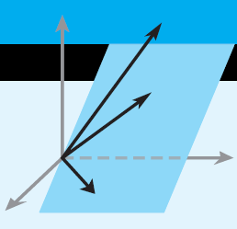
Elementary Linear Algebra
Howard Anton
Copyright © 2014 by John Wiley & Sons, Inc.
All rights reserved.
Chapter 1

Slide 2
Chapter 1
Systems of Linear Equations and Matrices
1.1 Introduction to Systems of Linear Equations
1.2 Gaussian Elimination
1.3 Matrices and Matrix Operations
1.4 Inverses; Algebraic Properties of Matrices
1.5 Elementary Matrices and a Method for finding A⁻¹
1.6 More on Linear Systems and Invertible Matrices
1.7 Diagonal, Triangular, and Symmetric Matrices
1.8 Matrix Transformation
1.9 Applications of Linear Systems
1.10 Leontief Input-Output Models

Slide 3
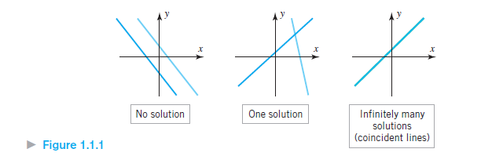
Linear Systems in Two Unknowns

Slide 4
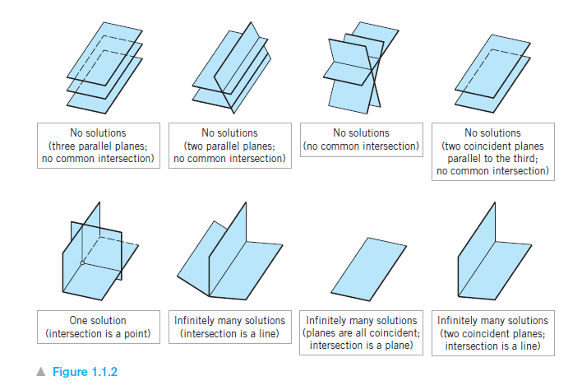
Linear Systems in Three Unknowns

Slide 5
Elementary Row Operations
1. Multiply a row through by a nonzero constant.
2. Interchange two rows.
3. Add a constant times one row to another.

Slide 6


Section 1.2
Gaussian Elimination
Reduced Row Echelon Form: Achieved by Gauss Jordan Elimination
Row Echelon Form

Slide 7
Homogeneous Systems
All equations are set = 0
Theorem 1.2.1 If a homogeneous linear system has n unknowns, and if the reduced row echelon form of its augmented matrix has r nonzero rows, then the system has n – r free variables.
Theorem 1.2.2 A homogeneous linear system with more unknowns than equations has infinitely many solutions.

Slide 8
Section 1.3
Matrices and Matrix Operations
Definition 1 A matrix is a rectangular array of numbers. The numbers in the array are called the entries of the matrix.
The size of a matrix M is written in terms of the number of its rows and the number of its columns. A 2x3 matrix has 2 rows and 3 columns

Slide 9
Arithmetic of Matrices
A + B: add the corresponding entries of A and B
A – B: subtract the corresponding entries of B from those of A
Matrices A and B must be of the same size to be added or subtracted
cA (scalar multiplication): multiply each entry of A by the constant c

Slide 10
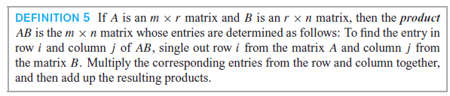
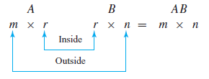
Multiplication of Matrices

Slide 11
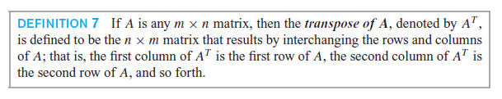
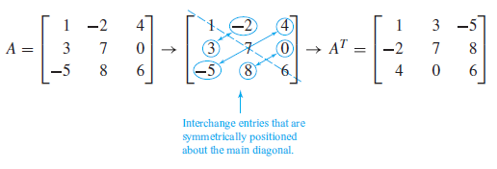
Transpose of a Matrix A^{T}

Slide 12
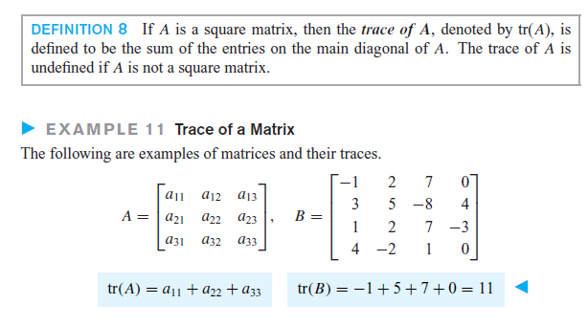
Trace of a matrix

Slide 13
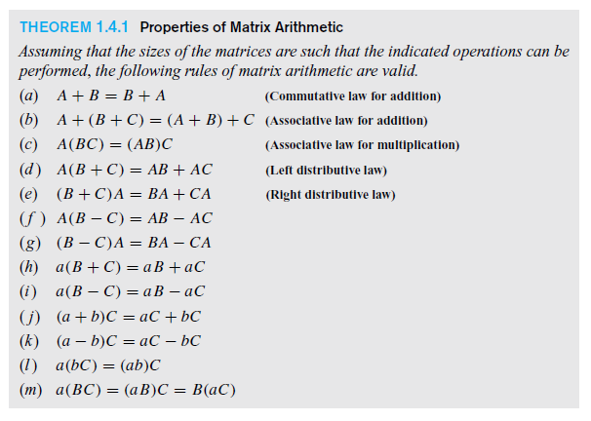
Section 1.4
Algebraic Properties of Matrices

Slide 14
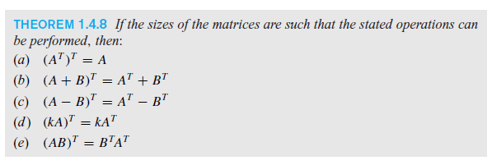

Transpose Matrix Properties

Slide 15
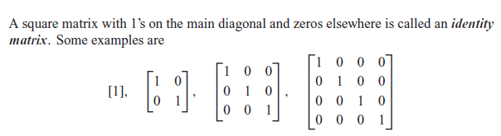
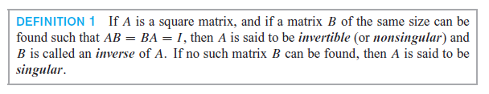

The identity matrix and Inverse Matrices

Slide 16
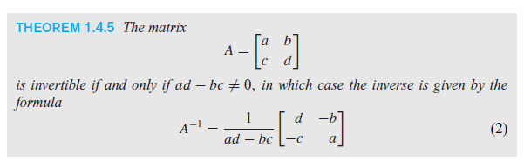
Inverse of a 2x2 matrix

Slide 17

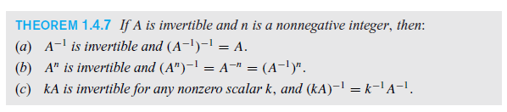

More on Invertible Matrices

Slide 18

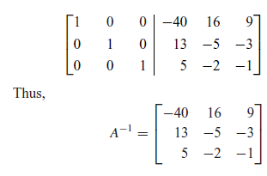
Section 1.5
Using Row Operations to find A⁻¹
Begin with:
Use successive row operations to produce:

Slide 19
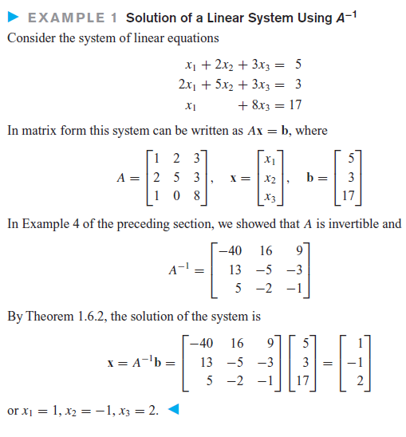
Section 1.6
Linear Systems and Invertible Matrices

Slide 20
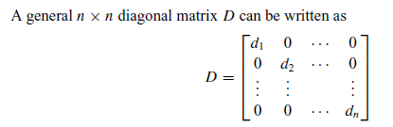
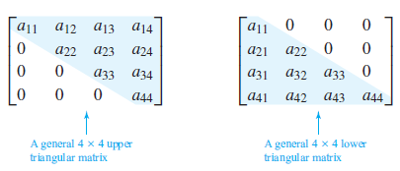
Section 1.7
Diagonal, Triangular and Symmetric Matrices

